Slide 1


Team Roles and Responsibilities
2210765029 Emirhan Utku
Stage 1: Aircraft Classification
2210356050 Gazi Kağan Soysal
Stage 2: Horizontal Object Detection
2210356035 Erdinç Arıcı
Stage 3: Oriented Object Detection

Slide 2
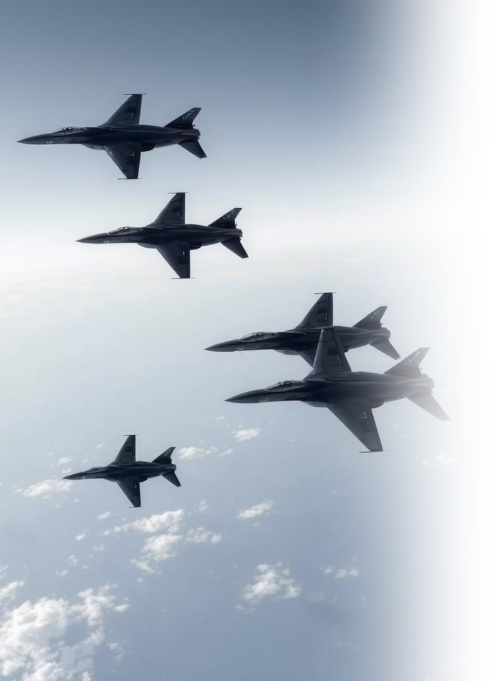
Improving Aircraft Classification and Detection via Super-Resolution
This presentation explores the effectiveness of Super-Resolution (SR) in enhancing military aircraft recognition. We investigate improving input quality for deep learning models, which is vital for aerial surveillance and defense applications. Our project addresses challenges like low-resolution imagery and varying object orientations that hinder model performance.

Slide 3
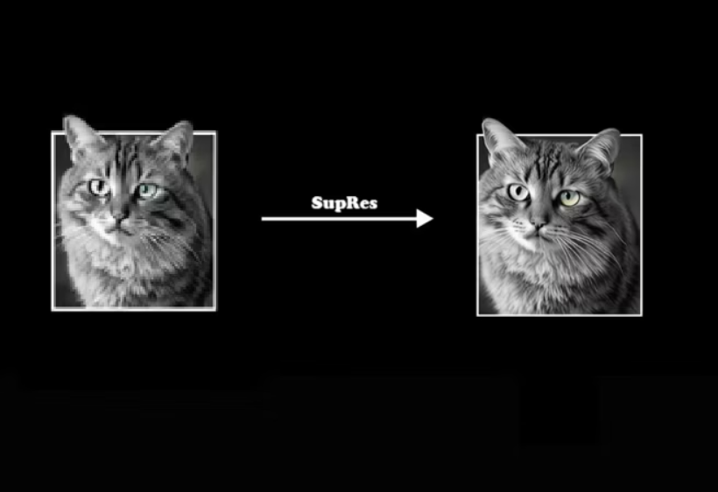
Project Overview: A Three-Stage Pipeline
Introduction to Super-Resolution
In defense and surveillance, it is important to identify aircraft accurately from aerial images. However, images often have low resolution and busy backgrounds that make this hard. Super-Resolution (SR) methods improve image details to help deep learning models work better.
Our project tests how SR helps in a three-step recognition process using the Military Aircraft Recognition Dataset. We check if SR makes identification more accurate at each step to understand its overall benefit.

Slide 4
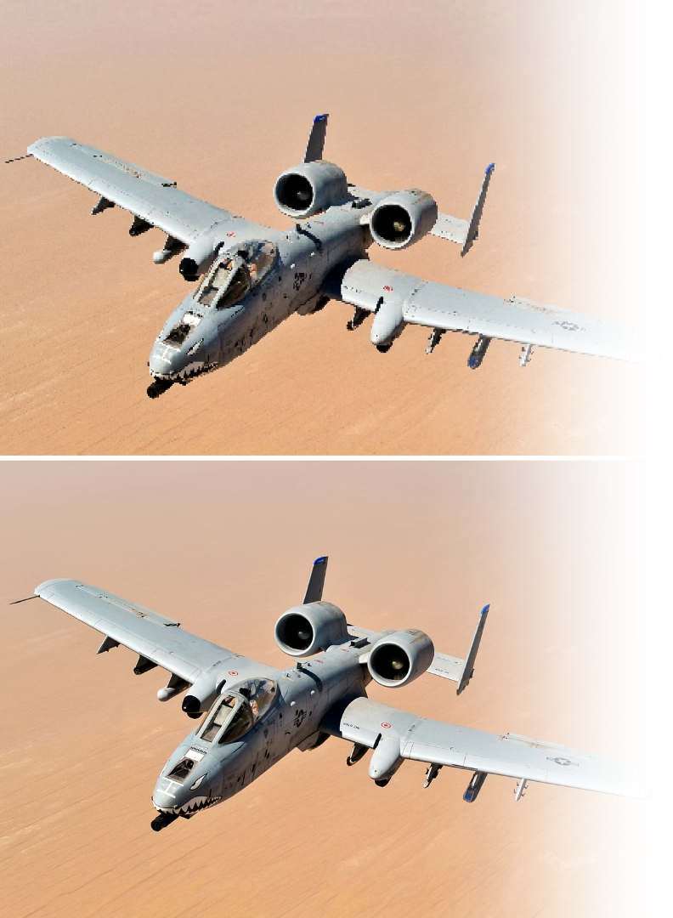


Stage 1: Aircraft Classification
Cropping Aircraft Regions
We isolated individual aircraft using horizontal bounding box annotations, allowing the model to focus on aircraft features without background noise. This object-level classification improves input data relevance.
Preprocessing Pipeline
Raw image data was converted into structured inputs. Aircraft were cropped, padded to a square, resized to 64x64 pixels, and normalized. Class labels were integer-encoded, and data was split into stratified sets for training, validation, and testing.
SR-Enhanced Classification
We compared MobileNetV2 models trained with original and SR-enhanced crops (using EDSR x4). Both were trained for 30 epochs, with validation accuracy tracked for optimal checkpoint selection. This setup allowed direct performance comparison.

Slide 5
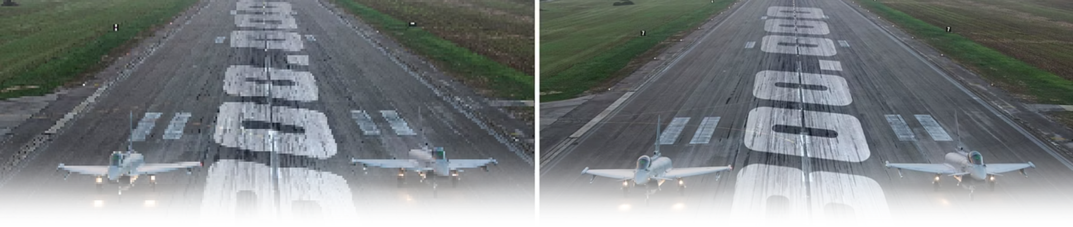



Stage 2: Horizontal Object Detection
Downsampling for Baseline
Super-Resolution Upscaling
YOLOv8n Training
Two YOLOv8n detectors were trained on downsampled and SR-enhanced sets using identical hyperparameters and annotations. Data augmentation was consistently applied.
Original high-resolution images were downsampled by a factor of four using bicubic interpolation, creating low-resolution baselines for detection.
These low-resolution images were then upscaled to original dimensions using the ESRGAN (RRDB) model to restore high-frequency details and edge sharpness.

Slide 6
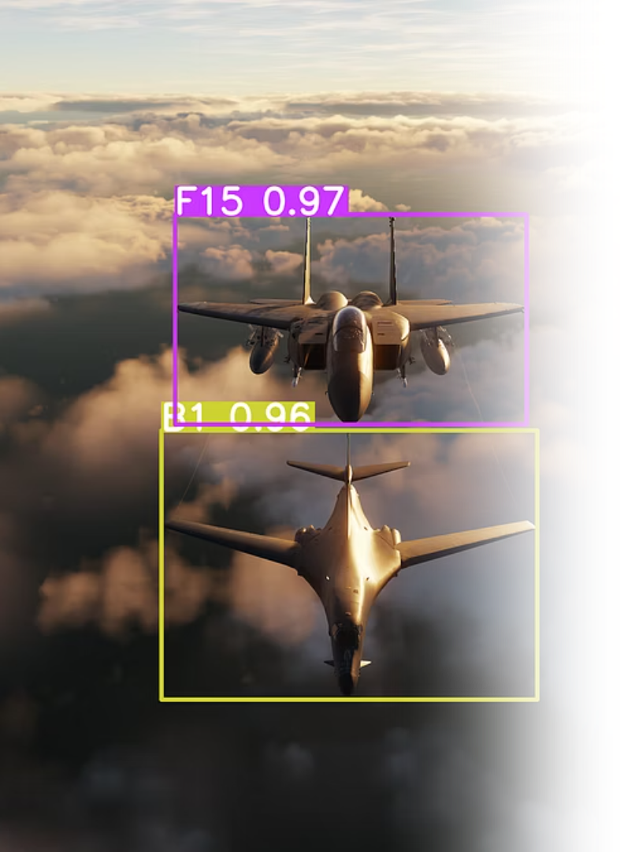
Stage 3: Oriented Object Detection
Rotation-Aware Preprocessing
Resolution Consistency
The dataset was curated to include images that are natively 800 × 800 px, so every sample enters the pipeline at a single, uncompromised resolution. Standard Ultralytics augmentations -flips, rotations, color jitter- enhanced diversity while keeping the image size intact.
XML annotations were parsed to extract polygonal OBB coordinates and converted to YOLOv8-OBB format. A stratified validation set was manually created to preserve class balance.
SR-Enhanced Workflow
Images were downsampled, then upscaled x4 using ESRGAN (RRDB) for the SR-enhanced pipeline. Both original and SR-enhanced inputs were processed identically for consistent comparison.

Slide 7








Experimental Settings and Data
Military Aircraft Recognition Dataset
Data Analysis
Exploratory data analysis revealed variations in class distribution and object sizes. Certain classes (e.g., A2, A14, A16) are more common, and most bounding boxes fall between 80-160 pixels.
Contains 3,842 aerial images and over 22,000 annotated aircraft instances across 20 classes, with both horizontal and oriented bounding boxes. Most images are 800x800 pixels.
Evaluation Strategy
Each stage was evaluated using task-specific metrics: accuracy, precision, recall, F1-score, confusion matrices for classification; mAP@0.5 and mAP@0.5:0.95 for object detection; and precision, recall, MSE of object counts, and exact match accuracy for oriented detection.
Environment
All implementations were developed using PyTorch and OpenCV, leveraging GPU acceleration for efficient training and inference.

Slide 8
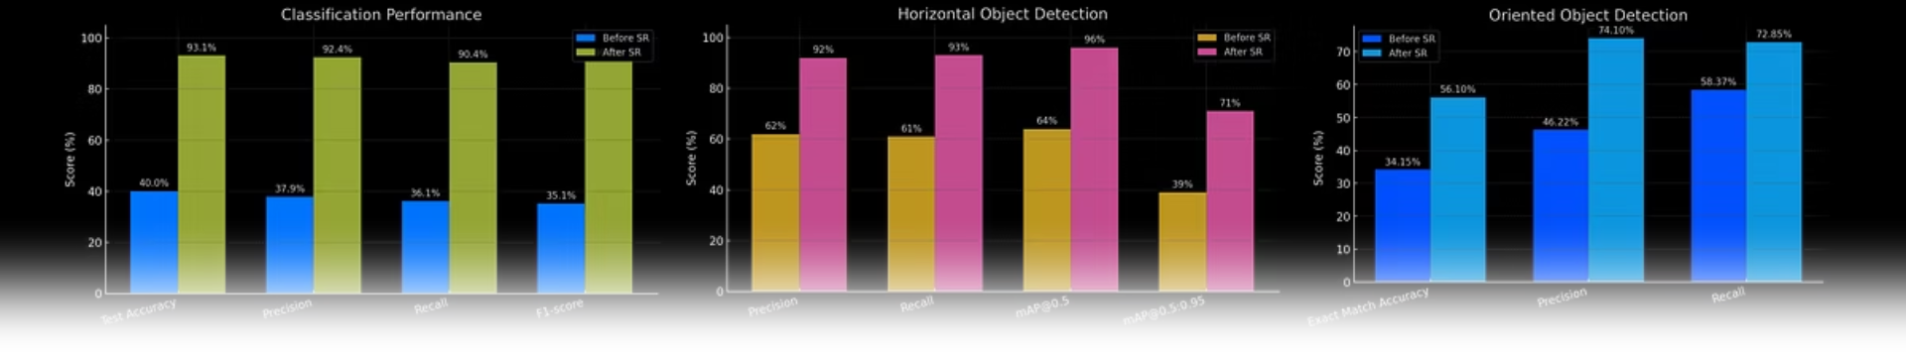
Key Results: SR's Impact on Performance
Stage
Task
Original Performance
SR-Enhanced Performance
1
Classification
Accuracy: ~40%
Accuracy: >90%
2
Horizontal Detection
mAP@0.5: 64%
mAP@0.5: 96%
3
Oriented Detection
Exact Match Accuracy: 34.15%
Exact Match Accuracy: 56.10%
Super-Resolution consistently improved recognition accuracy across all three stages. For classification, SR significantly reduced inter-class confusion. In horizontal detection, SR-enhanced models achieved notably higher precision, recall, and mAP scores. For oriented detection, SR led to better localization and angular accuracy, with exact-match scores increasing and count MSE halved.

Slide 9
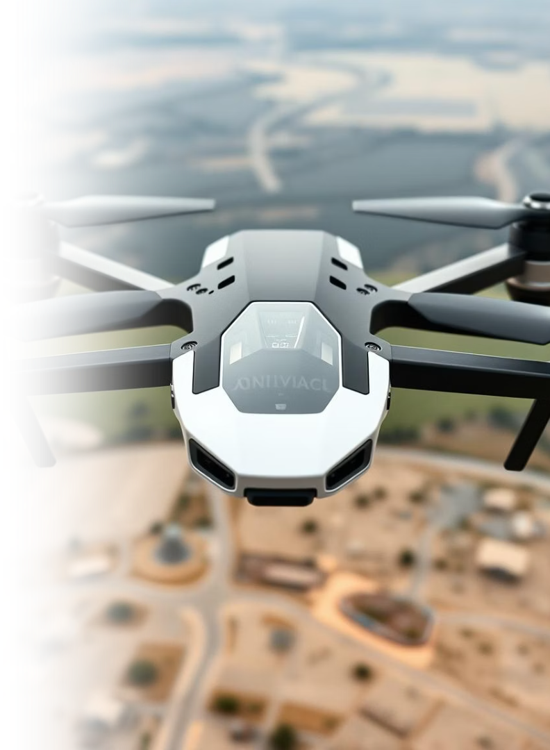



Discussion and Conclusion
Consistent Enhancement
SR consistently enhanced model performance across all three stages, proving to be a promising preprocessing step for low-resolution aerial vision tasks.
Addressed Challenges
The extra GPU memory pressure from SR-upscaled images was eased by switching to a lighter YOLOv8n backbone. Heavy CPU traffic during data loading was handled with parallel batch loaders that prepare samples in multiple threads. For steps that still exceeded local hardware limits, training was moved to Google Colab’s high-end GPUs, keeping the workflow smooth.
Future Work
Future work could explore adaptive or domain-specific SR to further improve accuracy while reducing resource demands, building on the demonstrated benefits.
This project successfully demonstrated the beneficial impact of Super-Resolution on military aircraft recognition. Despite challenges, SR significantly improved classification, horizontal object detection, and oriented object detection, highlighting its potential for real-world aerial analysis systems.

